Slide 1
ERASMUS +
PROSPECT

Slide 2
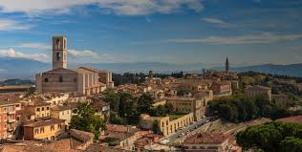
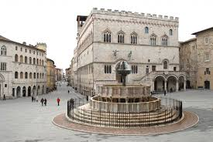
The Comprehensive Perugia 4 is near to the center of Perugia . the capital city of the region of Umbria in central Italy.
Perugia was one of the main Etruscan cities, it is crossed by the river Tiber.

Slide 3
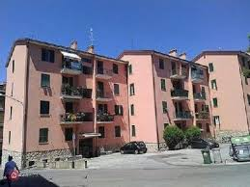
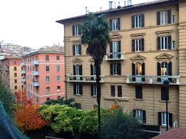
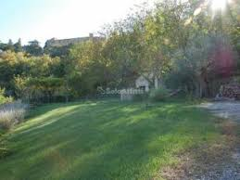
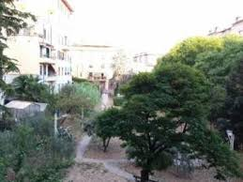
It’s characterized by the massive presence of buildings used for public services and activities of the tertiary sector and it’s between three park.

Slide 4
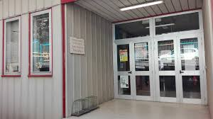
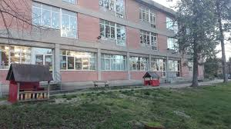
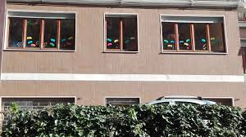
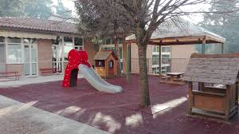
It has four nursery schools .
Two are Montessori’s nursey schools

Slide 5
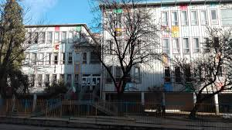
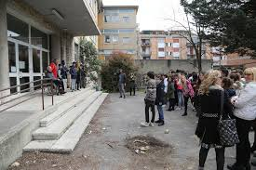
it includes two primary schools

Slide 6
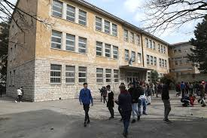
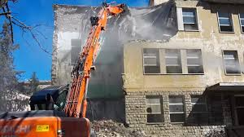
And one secondary school
Now the secondary school, due to the earthquake, has been demolished and will be rebuilt this year.

Slide 7
Our Projects

Slide 8
Our DIGITAL PROJECTS
WIKISO.IT
Digital storytelling
FIABE ONLINE
CoDING
3D
ROBOTIC
BIBLIOTECHE SCOLASTICHE INNOVATIVE

Slide 9
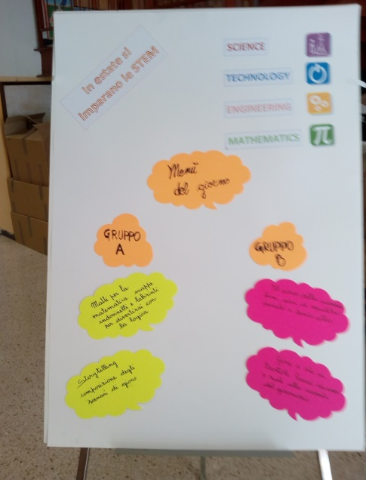
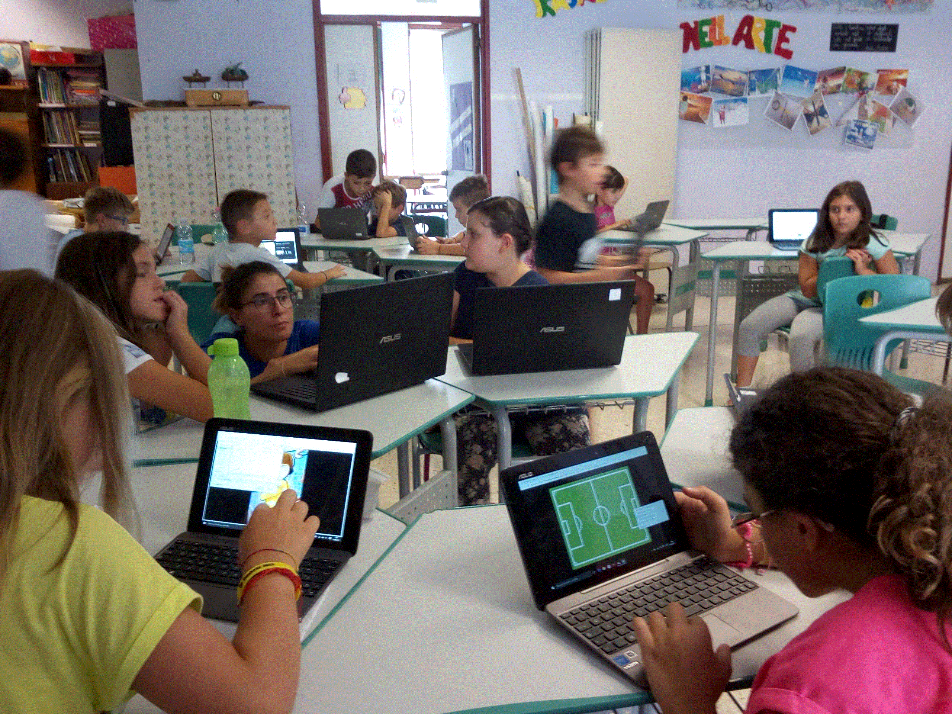

Slide 10
EU PROJECTS – SCHOOL EDUCATION
Creative Learning in Education United
Let´s enjoy the party

Slide 11
MANY
THANKS

